Slide 1
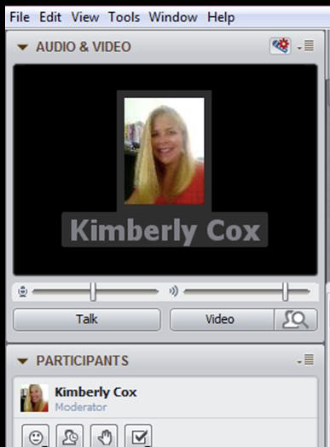
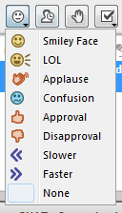
Audio Set Up
Before we start….
Please click on the audio set up button (looks like a blue microphone with a red gear), and the Audio Set Up Wizard will walk you through the steps to get your microphone and speakers working.
You can also adjust your speakers by moving the slider bar to the right or left.
Blackboard Tools

Slide 2
Welcome
to
Michigan Great Lakes Virtual Academy
2014-2015 New Family Orientation
*If you have not signed in with your first and last name, please exit and re-enter with your first and last name.

Slide 3
Agenda
Strong Start Website
Strong Start Strong Finish Locations
Michigan State Testing Dates (Required to Attend)
Setting up the student account
Accessing Courses
Online Learning Course
Attendance
Student Home Page
Scantron
Study Island

Slide 4
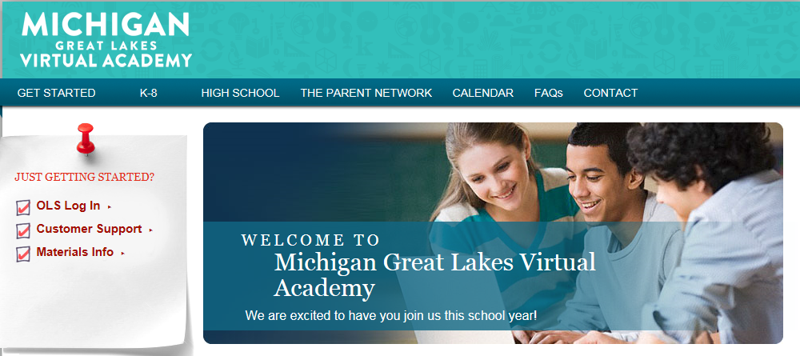
Strong Start Website
Website: http://mglva.k12start.com/
This website is designed for families. The Strong Start website contains a wealth of information such as orientation videos, parent workshops, and FAQs.

Slide 5
Strong Start, Strong Finish Sessions – Monday’s
Locations:
Great Wolf Lodge
3575 U.S. 31
Traverse City, MI 49684
Bay Valley Resort
2470 Old Bridge Road
Bay City, MI 48706
Muskegon Community College
221 Quarterline Road
Muskegon, MI 49442
Boys & Girls Club of Troy
3670 John R Road Troy, MI 48083
Henry Ford Community College
Detroit, MI
Check kmail for more information.

Slide 6
Michigan State Testing Information (Required Testing)
State Testing Information:
Window #1 (ACT/WorkKeys) 11th Grade only
March 3 – ACT
March 4 – WorkKeys
March 17 – ACT Make-up
March 18 – WorkKeys Make-up
Window #2 (April 14 – May 1: 5th & 8th Grades)
April 14-16 – 5th & 8th Grades (2 full days + ½ day)
April 17 & 20 – scheduled make-up dates for 5th & 8th
Window #3 (April 28 – May 15: 4th, 7th & 11th Grades)
April 28-30 – 4th, 7th & 11th Grades (2 full days + ½ day for 4th & 7th, 3 full days for 11th)
May 1 & 4 – scheduled make-up dates for 4th, 7th & 11th
Window #4 (May 19 – June 5: 3rd & 6th Grades)
May 19 & 20 – 3rd & 6th (2 full days)
May 21 & 22 – scheduled make-up days for 3rd & 6th

Slide 7
What does “Flexibility” mean?
What Flexibility means to MGLVA:
Students may choose which class to work on first each school day.
Students can access the content 24 hours a day/7 days a week.
Students can work ahead in OLS courses.
Students can block their schedules.
Students can work anywhere in their homes or wherever they have an Internet connection.
What Flexibility does not mean at MGLVA:
Students may not work on one year’s curriculum over a longer period.
Students may not opt out of required course work.
Students may not opt out of K12 mandated testing or state testing.

Slide 8
Graduation Requirements
Students must complete all Michigan Merit Curriculum requirements for a total of 22 Credits.
Traditional Diploma
2015 Grads = 16 Core Academic + 6 Elective Credits
2016 Grads = 16 Core Academic + 2 World Language + 4 Elective Credits
Students take 6 courses each semester
Math 4 Credits
English 4 Credits
Science 3 Credits
Social Studies 3 Credits
PE/Health 1 Credit
World Languages 2 Credits (2016 Grads and beyond)
NOTE: Academic Courses will be assigned by counselors as needed to complete all MMC requirements.

Slide 9
High School Requirements
All students will be placed in 9th, 10th, 11th, or 12th grade using the credit scale below:
0-4.99 Credits – 9th Grade
5-10.99 Credits – 10th Grade
11-15.99 Credits – 11th Grade
16-22 Credits – 12th Grade
Grading Scale:
A 4.0 93-100% C 2.0 73-76%
A- 3.7 90-92% C- 1.7 70-72%
B+ 3.3 87-89% D+ 1.3 67-69%
B 3.0 83-86% D 1.0 63-66%
B- 2.7 80-82% D- 0.7 60-62%
C+ 2.3 77-79% F 0.0 0-59%

Slide 10
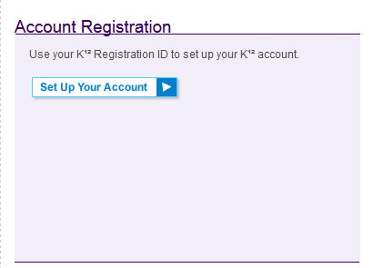
Learning Coaches Please log in to your OLS (Online School)
Log in as the LC, go to http://www.k12.com/
We will walk through some screens together looking at your account.
If this is your first time, click on ‘Set Up Your Account’
Your registration ID should have been emailed to you. If you do not have it, I can retrieve it for you.
Notes:
If you need a registration ID, you can access that on an omnibus as long as their registration has been approved.

Slide 11
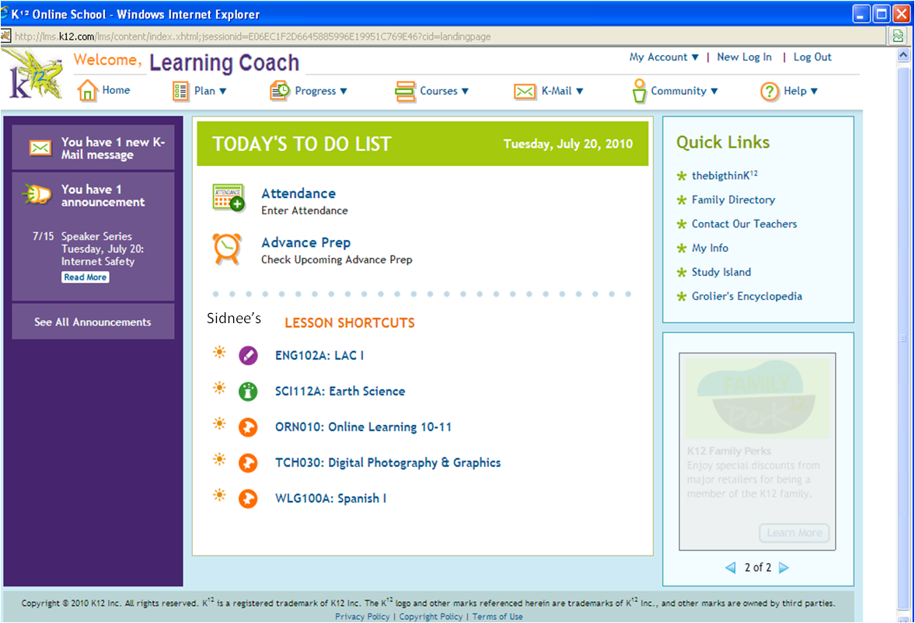
Creating the Student’s Account
Sam’s
In the High School Platform, it is mandatory to have two separate accounts; the Learning Coach account and the Student account.
Notes:
The Learning Coach/student name will show in the top part of the screen when logged in.
In the High School platform it is mandatory to have two separate login accounts: Learning Coach & Student.

Slide 12
Creating the Student’s Account
Notes:
Take the time to have them do this now. Answer any questions now.
Complete the username, password, and verified password fields. Verify the home phone, mailing and shipping addresses. Make any changes to the home phone. Click on Save. DONE!

Slide 13
Accessing your Student’s Courses Online Learning Course

Slide 14
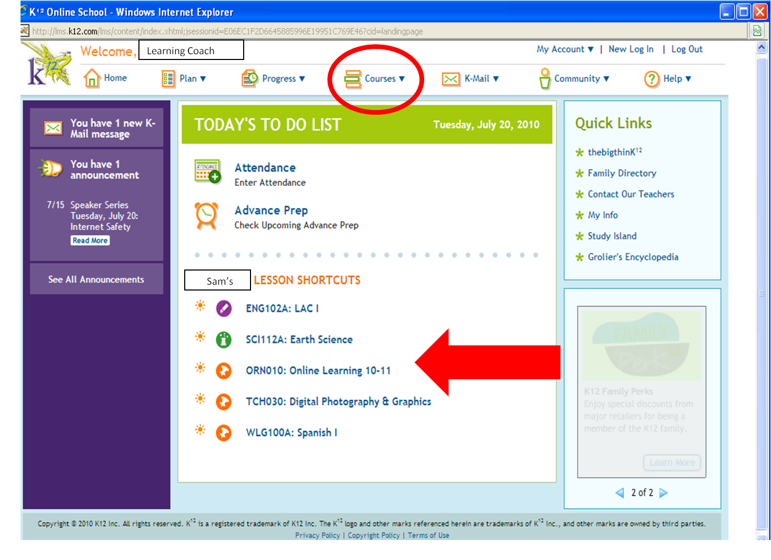

Slide 15
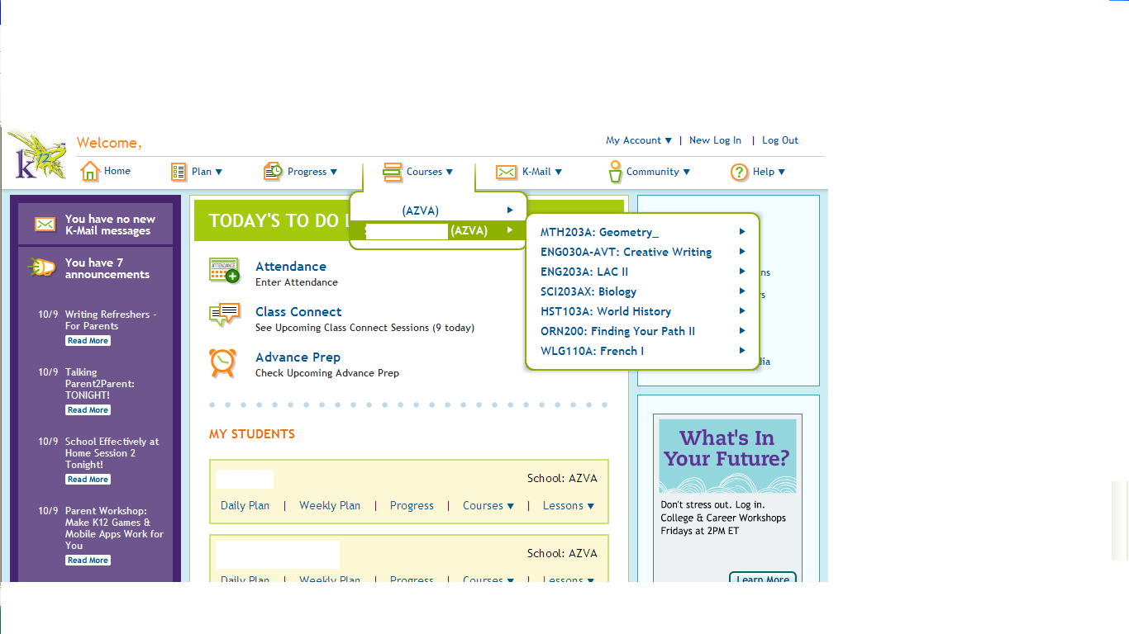
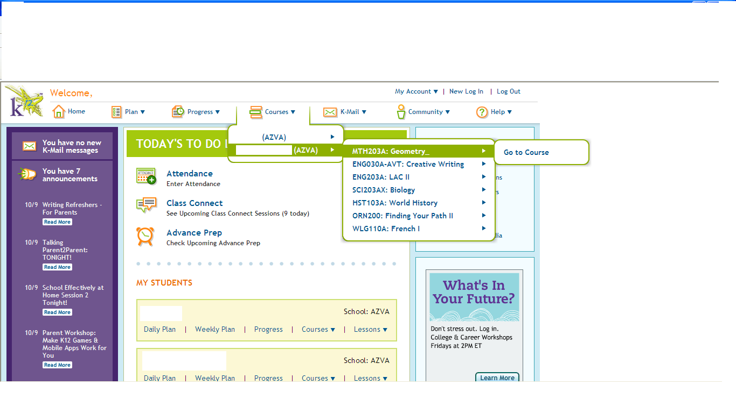

Slide 16
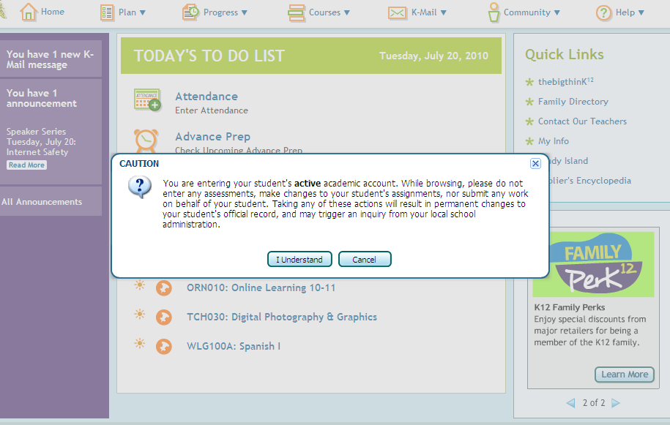
Click on “I Understand” to continue.
Caution Message

Slide 17
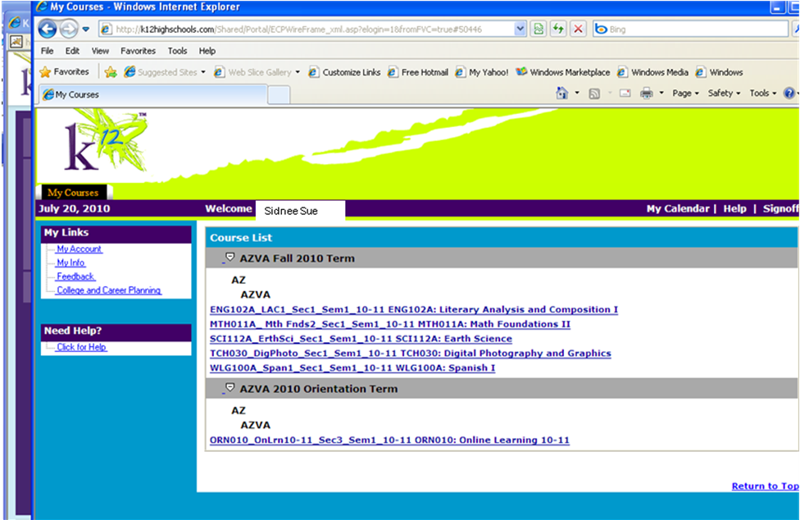
“Course List” will appear in a separate window
Mrs. Cichon
The first course students need to complete is Online Learning course.

Slide 18
Online Learning Course
This is the first course your student should complete
This is exactly how the course looks when students log in from their student homepage, so students should pay attention to this too.
Notes:
Give brief intro of OL; explain that you will go over specific course items in the next slides (gradebook, dropbox, etc.)Also explain that this is exactly how the course looks when the student logs in from their homepage, so students should pay attention to this too!

Slide 19
Checking the Grade Book and User Activity

Slide 20
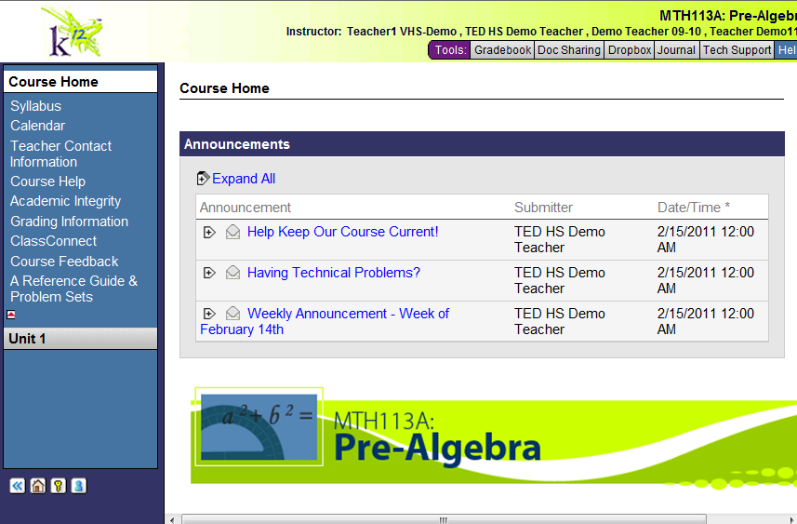
Click on the “Gradebook” tab…
The course homepage is exactly what it will look like for students when they access the course through their Student account. I will let you know what the student homepage looks like later in the presentation.
Notes:
Explain that this course home page is exactly what it will look like for the student, and let them know you will show them the student homepage later in the presentation.

Slide 21
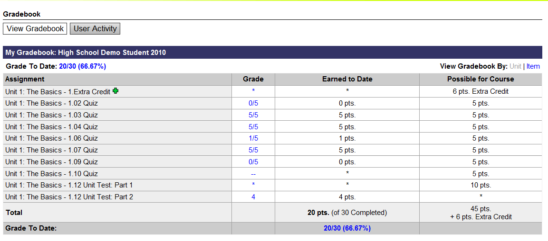

Slide 22
User Activity Summary
Total
Click on student name for more information

Slide 23
User Activity by Unit

Slide 24
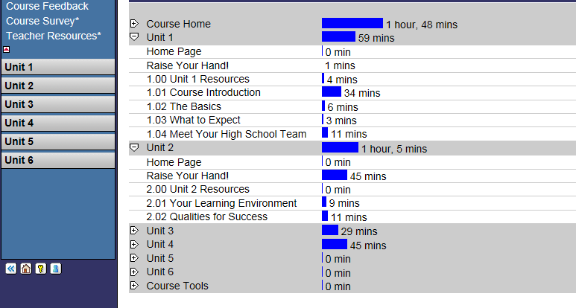
User Activity by Section
Click on the plus sign next to each unit to see how many minutes the student spent in each section

Slide 25
Announcements
and Teacher Contact Information

Slide 26
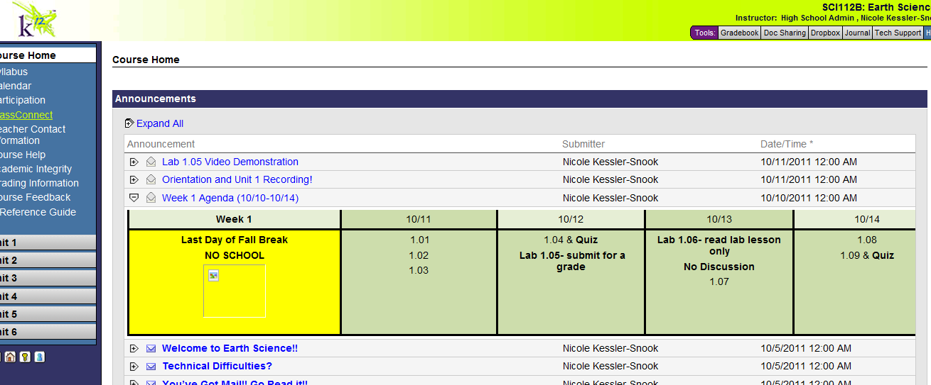
Once in the class, click on the Weekly Assignment announcement.

Slide 27
Locating the Teacher Contact Information

Slide 28
Instructional Time
and
Logging Attendance

Slide 29
Instructional Time
Kindergarten – 12th Grade Need 1,098 Hours of Instruction – State Law
Your student must spend a minimum of 6 hours and 20 minutes per day on coursework.
Students must attend homeroom sessions when scheduled.
Students must attend live academic and support sessions when scheduled.
You must login and record attendance every day!
Students are required to follow the school calendar. Instructional time can be entered on any day (e.g., weekends, holidays, etc.).
Students are expected to log into the OLS (K-8) LMS (9-12) each scheduled school calendar day.

Slide 30
Attendance and Truancy
We, as well as the Michigan Department of Education, take your student’s attendance very seriously. Students achieve when they are present and engaged in the learning.
YOU MUST LOGIN EVERY DAY!
5 Absences = Letter
8 Absences = Meet with Admin/Teacher to develop a Success Plan
10 Absences = Truancy Proceedings/Possible withdrawal from MGLVA

Slide 31
2014 – 2015 School Year Academic Calendar * Subject to change
September 2 | First Day of School
October 1 | Pupil Count
October 22 | No School – Teacher Professional Development
November 26-28 | No School – Thanksgiving Break
December 4 | No School – Teacher Professional Development
December 22-Jan. 2 | No School – Winter Break
January 19 | No School – Martin Luther King, Jr. Holiday
January 21-23 | Exams – 1st Semester
January 23 | 1st Semester Ends
January 26-27 | No School – Semester Break
January 28 | First Day of 2nd Semester
February 11 | Pupil Count
February 13 | No School – Presidents Day
February 20 | No School – Teacher Professional Development
March | Required State Testing
April 3-10 | No School - Spring Break
May 5 | No School – Teacher Professional Development
May 25 | No School – Memorial Day
June 3-5 | Exams – 2nd Semester for Seniors
June 5 | Last Day of School for Seniors
June 9-11 | Exams – 2nd Semester for underclassmen
June 11 | Last Day of School
June 13 | High School Graduation

Slide 32
Entering Attendance

Slide 33
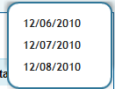
Sidnee’s Attendance

Slide 34
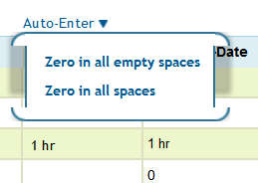
How do I enter attendance for a day my student is unable to school? Excused absence
Click on the Auto Enter feature located right above the “Enter Time” column.
And then choose “Zero’s in all empty spaces”.
Notes:
FSL
Discuss absences – excused = zero’s. Unexcused = blank.
Discuss attendance policies.

Slide 35
Student Dashboard
(also known as the Student Homepage)
Students, please log in to www.k12.com

Slide 36
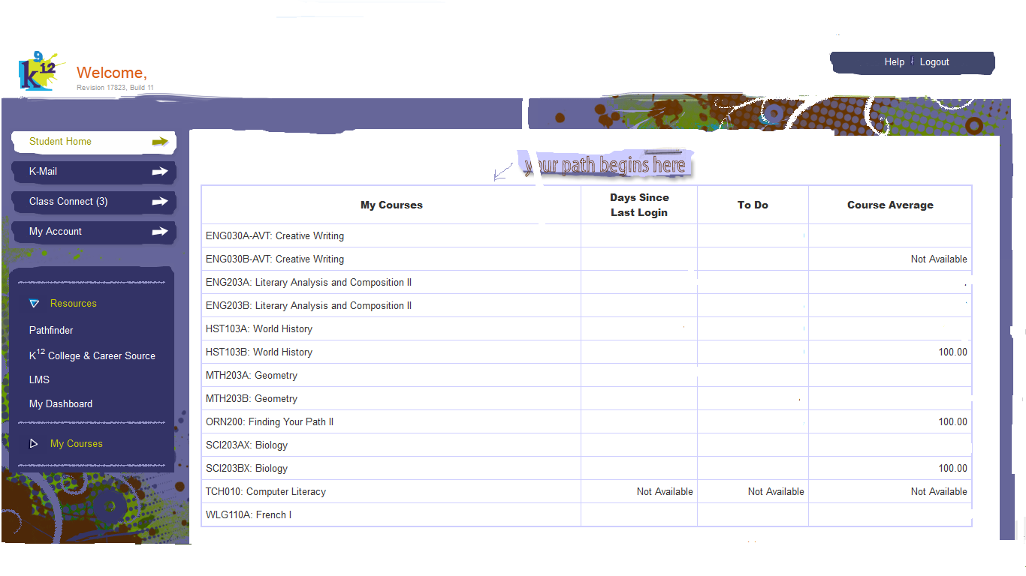
Student Dashboard
Click on the course you
want to enter.

Slide 37
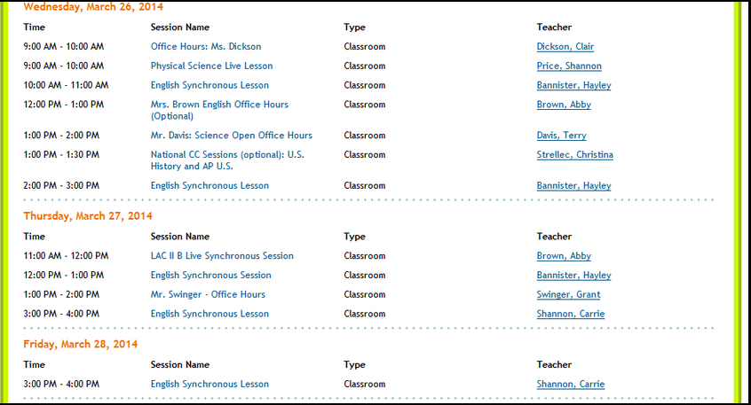
High School (LMS) Sample Course List (Class Connects) Example

Slide 38
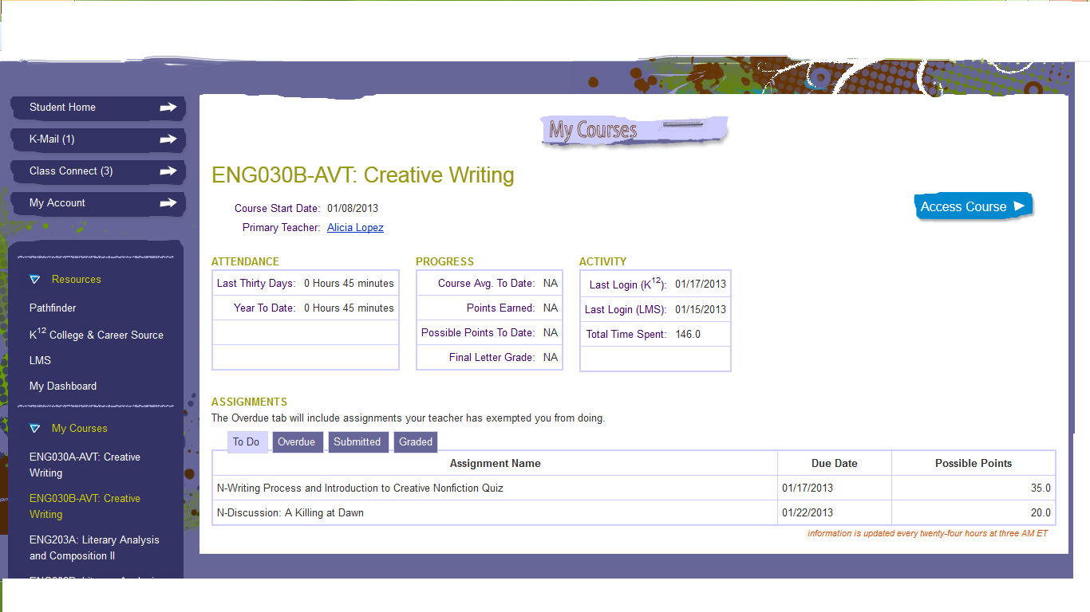
Course Tools Page

Slide 39
Scantron Performance Testing
What they are and how they help us…

Slide 40
What is Scantron?
The login is sent to your Kmail inbox
Provides detailed information on skills students have acquired and areas showing their weaknesses.
Assists in goal setting for the year.
Allows us to measure growth over the course of the year.
Scantron tests are due upon enrollment or the beginning of the school year and at the end of the school year.
All 3rd - 11th grade students must complete the Reading and Math tests only. Do not complete the Reading Foundations Test

Slide 41
How Do I Access the Scantron Tests?
Go to www.edperformance.com Click on Student Login

Slide 42
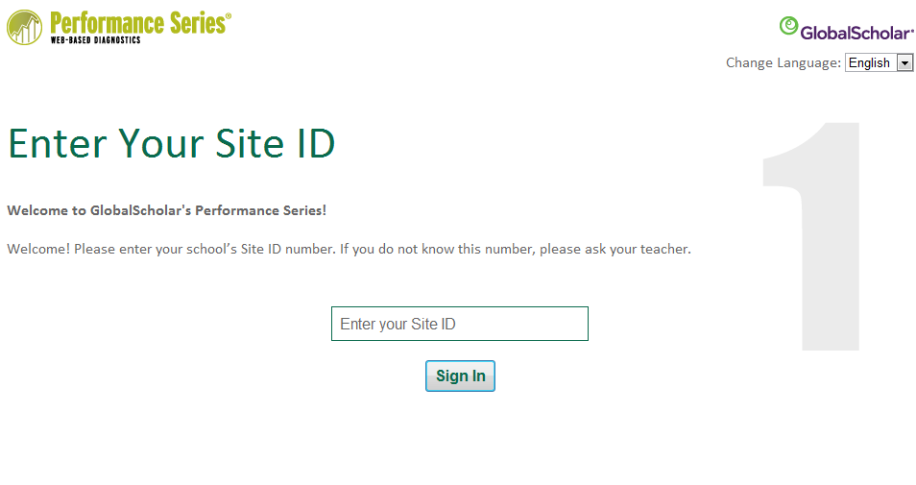

Slide 43
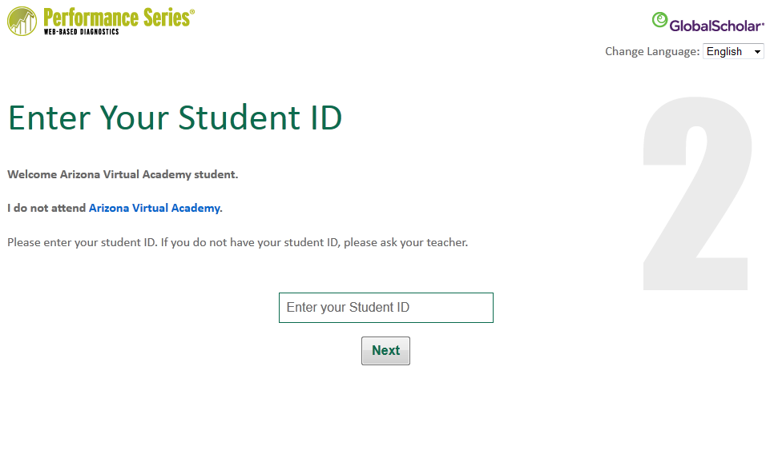

Slide 44
Sally Student
Sally Student?

Slide 45
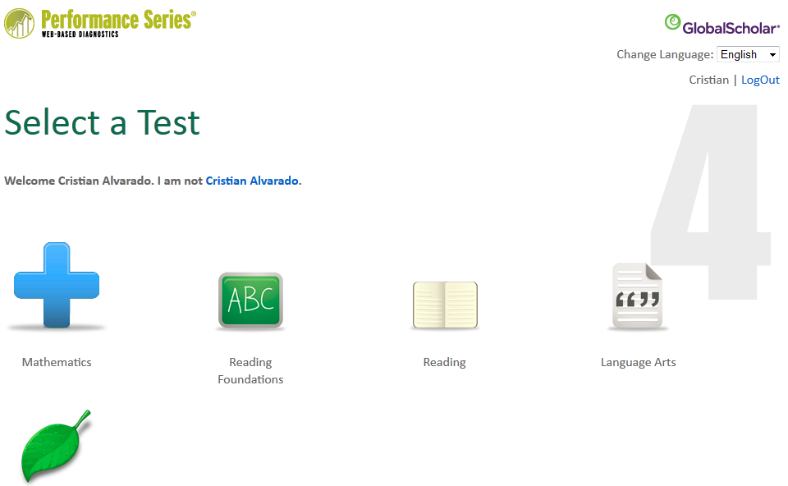
Sally Student
Sally Student
Sally Student
Complete the Math Test
Complete the Reading Test
Do not complete the Reading Foundations Test

Slide 46
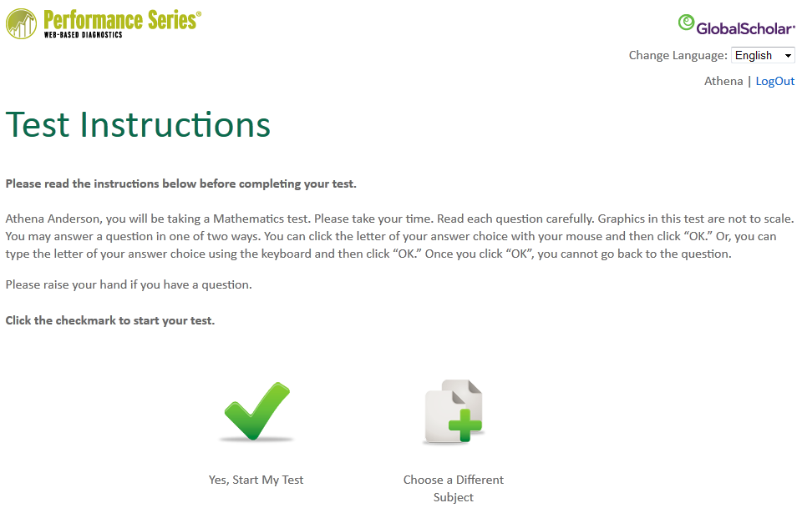
Sally Student
Sally Student

Slide 47
Important Information About Completing Your Test
After each question, you will be prompted to continue or to stop. If you choose to stop the test, it must be completed within one week or it will be spoiled and you will have to re-take the entire test.
The test contains an irregularity detector. It’s very important to do your best and answer all items carefully. If you are answering questions so quickly that it is not possible for you to have read the questions, the detector will consider this as guessing. The test will stop if you are guessing. You will have to start over from the beginning if test irregularities are detected.
When you finish the questions, the test lets you know you are done.

Slide 48
Study Island
How to access and work in Study Island…

Slide 49
Study Island
Test preparation site used by all of K¹²
Great for State Test preparation
Usernames and passwords were K-Mail’d to the students
11th Grade students will be expected to complete activities assigned by their Math and English teachers
Time spent in Study Island can be logged as attendance

Slide 50
How to find your courses in Study Island

Slide 51
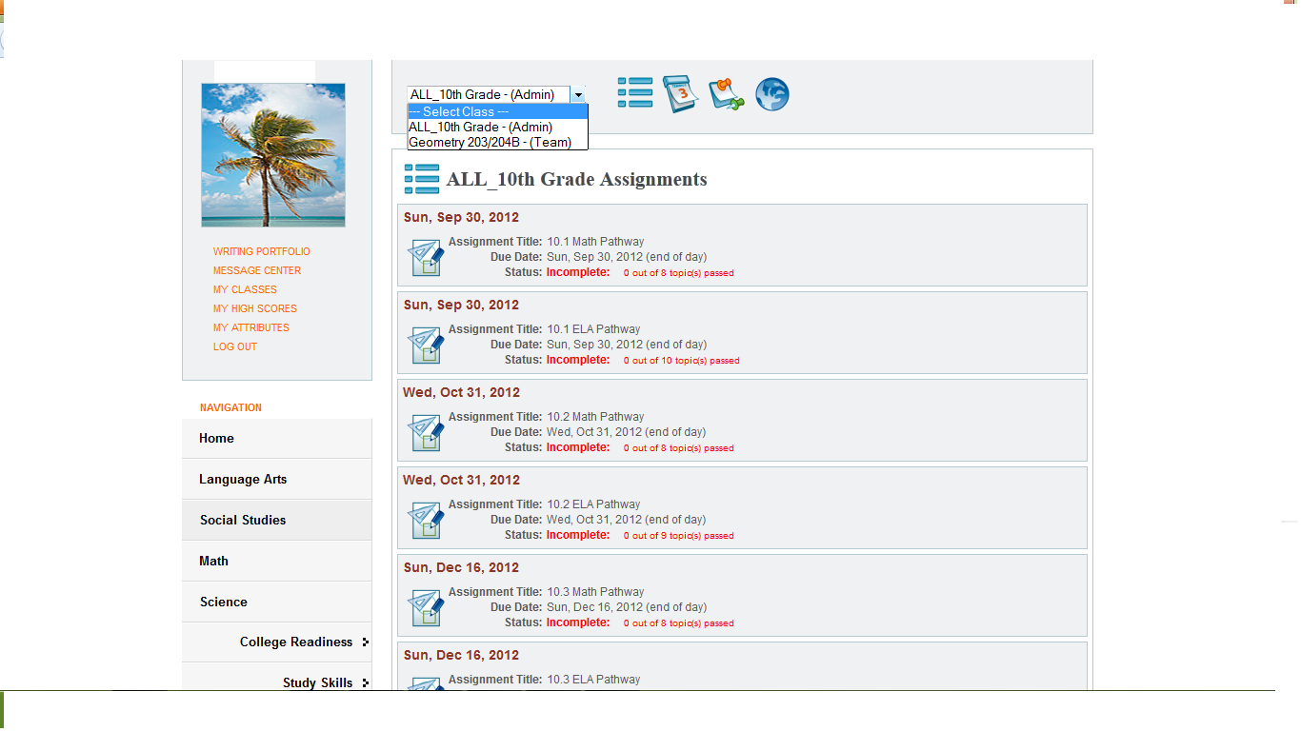

Slide 52
High School Student’s Role
In the K12 High School Program, you as the student, working in conjunction with your teacher and closely with your Mentor, are responsible for your success!
Students must spend a minimum of 6 hours and 20 minutes per day on coursework. Your schedule can be flexible but the 6 hour total is not. (Stay tuned to understand “flexible” in the high school model.)
Students must be willing to work with their mentor on a daily basis to ensure that they are on track.
Students must keep track of time spent in each course so that their mentors can log it daily.
Students must communicate with teachers and seek help before they get too far behind.
Students must work in a distraction-free space.
Students must attend homeroom each week.
Students must attend live Class Connect (CC) sessions and any assigned support sessions.
Students must work to complete all coursework by assigned due dates.

Slide 53
High School Parent’s/Mentor’s Role
In the K12 High School Program, you as the parent, working in conjunction with a Highly Qualified teacher, serve as a Mentor for you student. In high school, the mentor helps with things that don’t always come naturally to teenagers, such as organization, motivation, communication and accountability.
Your student must spend a minimum of 6 hours and 20 minutes per day on coursework.
Mentors should plan to spend a minimum of 45 minutes to an hour per day with their student.
Mentors spend time reviewing what their student has accomplished during the day and help their student make adjustments if he/she falls behind.
Mentors are responsible for logging attendance for each day of school!
Mentors must encourage their student to communicate with teachers as needed.
Mentors monitor student engagement, participation and progress.
Mentors must read all k-mails and respond within 24 hours.

Slide 54
Thank you for attending!
Please feel free to kmail or call me ☺

