Slide 1
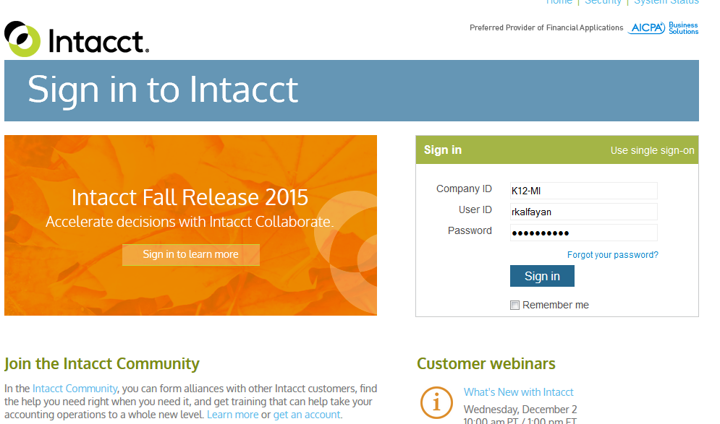

Slide 2
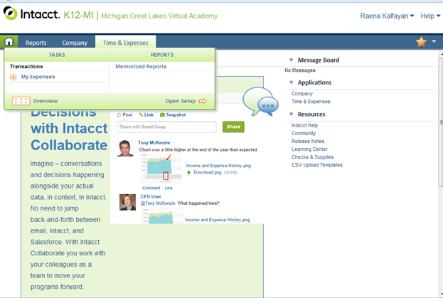
On your home screen click on:
Time & Expenses
My Expenses

Slide 3
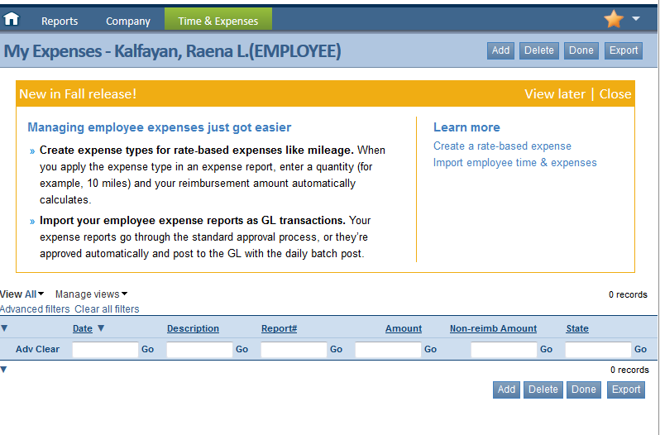
To create a new report, click on Add
If you have one already created and saved in draft, it will show on the list.

Slide 4
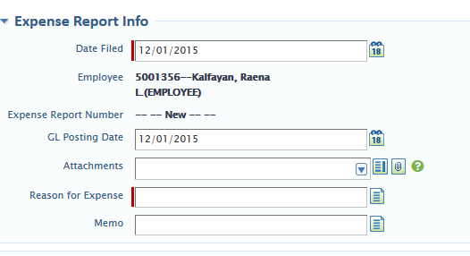
Date Filed: The date you are completing the report.
Employee: Will have your name.
Expense Report Number: Will auto populate.
GL Posting Date: Ignore
Attachments: See next slide
Reason for Expense: Keep short
i.e. Manistee PD
Memo: Longer description if needed.

Slide 5
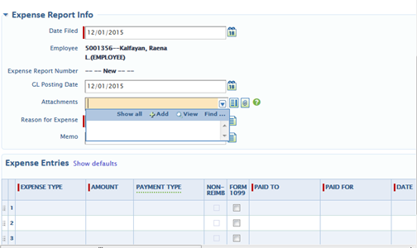
Attachments
Click on the drop down arrow and choose Add
Do not use the Show All option, this brings up every attachment name ever used

Slide 6
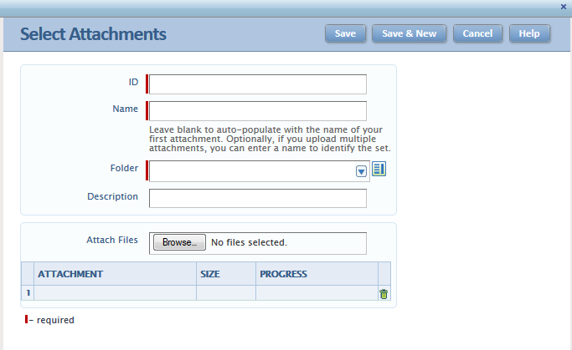
The ID MUST be in the same format for each report:
15.11.RK-Opendesc
(first two digits of year.day.initials-opendescription)
Name: Descriptive name for attachment (i.e. trip to outing)
Folder: See next slide for naming code.
Attach files. Files can be in any format: jpeg, excel, pdf, gif, etc. You can also take a picture with your phone and email to yourself, then save to your hard drive to attach.
It is easier for approval to have all receipts in on file, they do not have to be in order of line item.
Description: extended description for supporting documents.

Slide 7
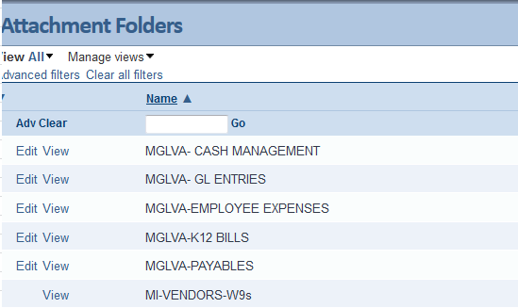
Teacher-Internet
45.00
Charter
Internet
11-1-15
Expense type: Use teacher expense types from drop down.
Amount: Dollar amount.
Payment Type, Non-Reimb & Form 1099: Ignore
Paid to: Company paid to
Paid for: Internet
Date:
Date paid

Slide 8
Dept. , Function and Transaction Code will auto populate. Anything in orange needs to be edited (see next slide for codes).

Slide 9
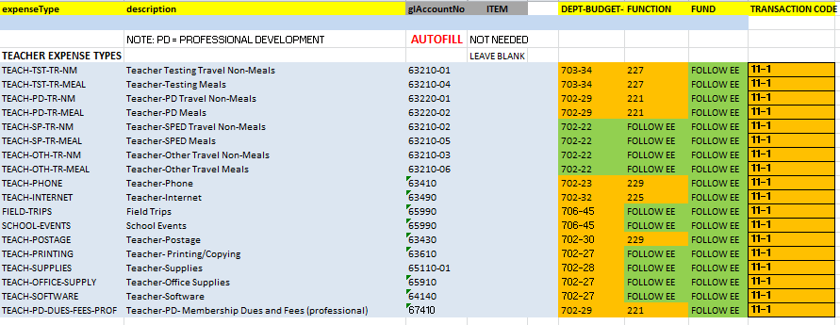
Dept. , Function and Transaction Code will auto populate. Anything in orange needs to be edited.

Slide 10
If you have completed everything and are ready, click submit. Once submitted, you will not be able to make any changes.
If you still have items to add, you can save the report as a Draft and return to it later.

Slide 11
Additional Q & A
Q. What about mileage?
List mileage as “Travel no meals” in the Expense Type section and “mileage” in the Paid to and Paid For sections.
You need to calculate the rate for mileage and put the dollar amount in. # of miles x rate = dollar amount Ex: 54 miles x .575 = $31.05
Q. What if an item is rejected?
With this program, partial reports can be accepted and paid out. If an item is rejected, you will get an email notifying you. You can then expense that item on the next months report with any additional documentation necessary.
This way, your whole expense report is not held up of one item. The rest of the items, when approved will be send on for payment.
You will also receive an e-mail once the report has been approved.

